Slide 1

Progressive
Web Application
And Wordpress
Oslo WordCamp
3rd, March 2018
Majid Hajian

Slide 2




ABOUT ME
Passionate web developer
Open Source lover and contributor
Public tech speaker, Organizer
PacktPub Instructor and trainer
Wordpress Fan
Oslo Vue.js meetup Organizer
Angular and Mobile meetup co-organizer
Majid Hajian
@mhadaily

Slide 3


Slide 4
Content Overview
What is really a PWA?
What Progressive web app means?
Manifest dot JSON
Makes your app installable
Core Concepts
What make an app
a progressive web app
Dive into service worker
What service worker life cycle,
What is pre-cache ?
Advanced Cache Strategies
Dive into cache strategies and understating
How they work
Why PWA? And Essentials
Why you should consider a PWA and do you need?

Slide 5
WHAT REALLY IS A PWA

Slide 6
native-app like experience

Slide 7

CORE
CONCEPTS

Slide 8


Slide 9
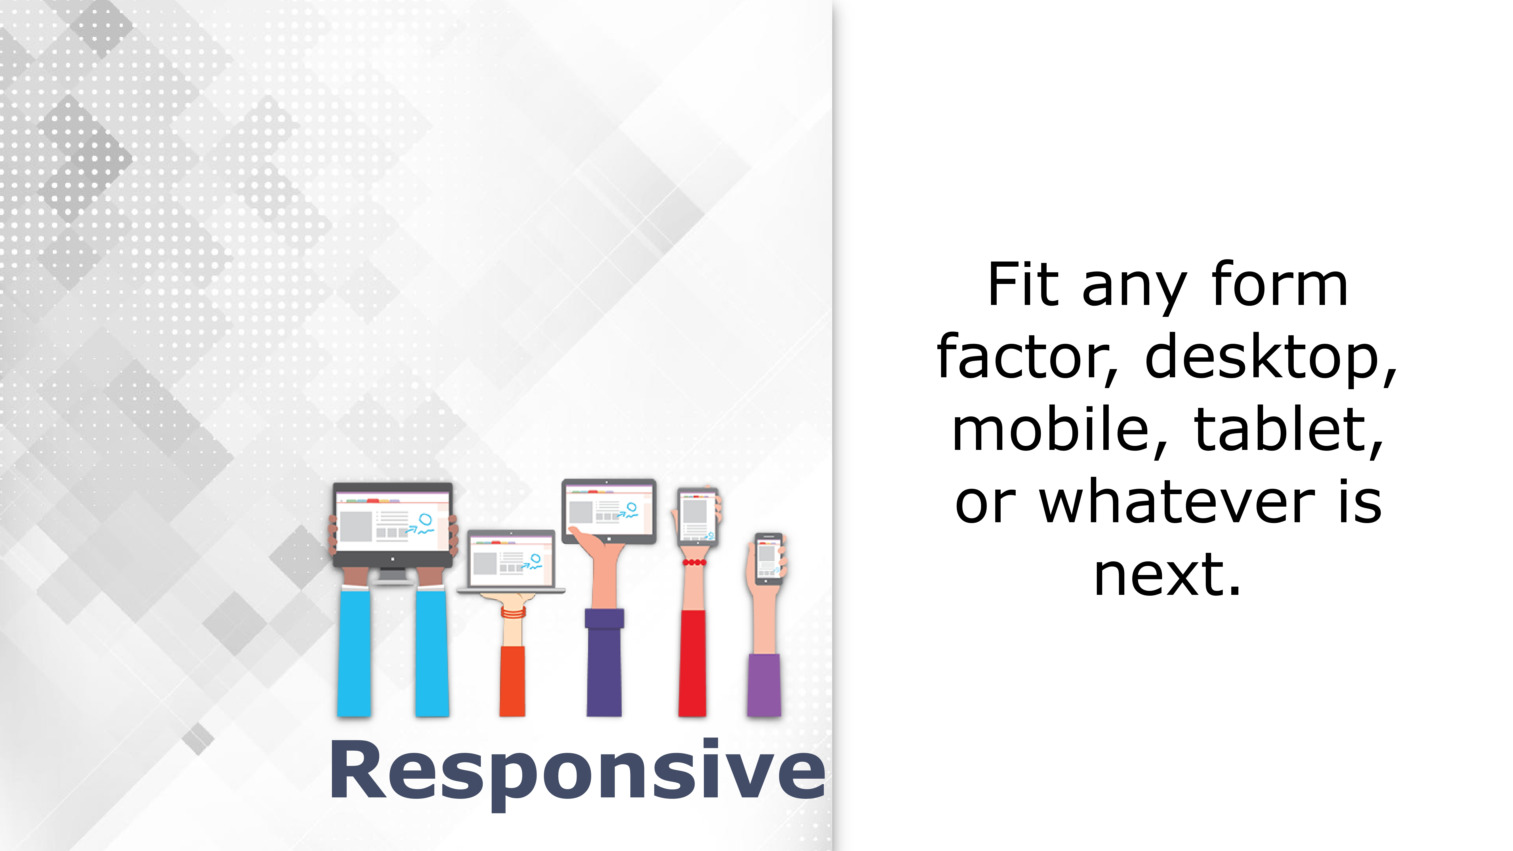

Slide 10
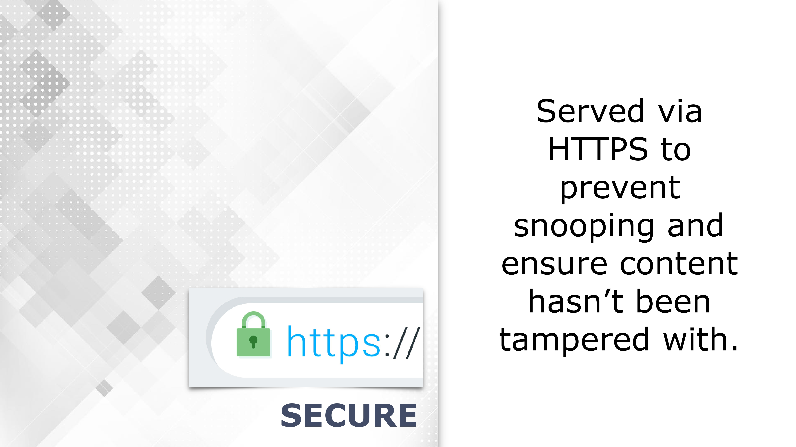

Slide 11


Slide 12
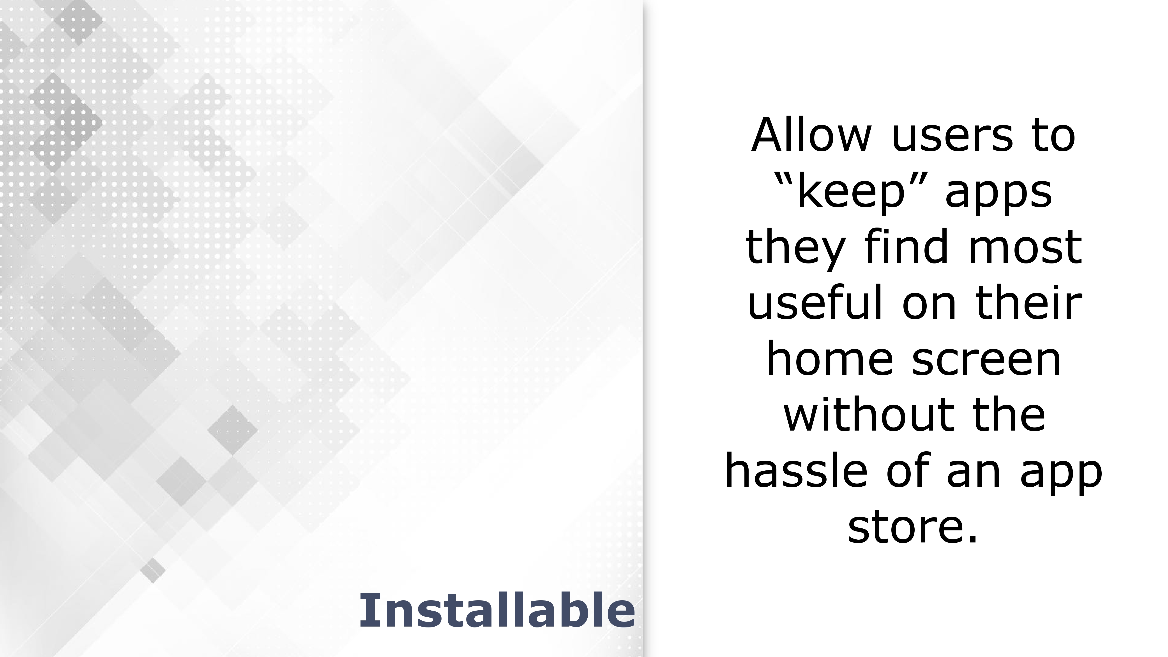

Slide 13


Slide 14
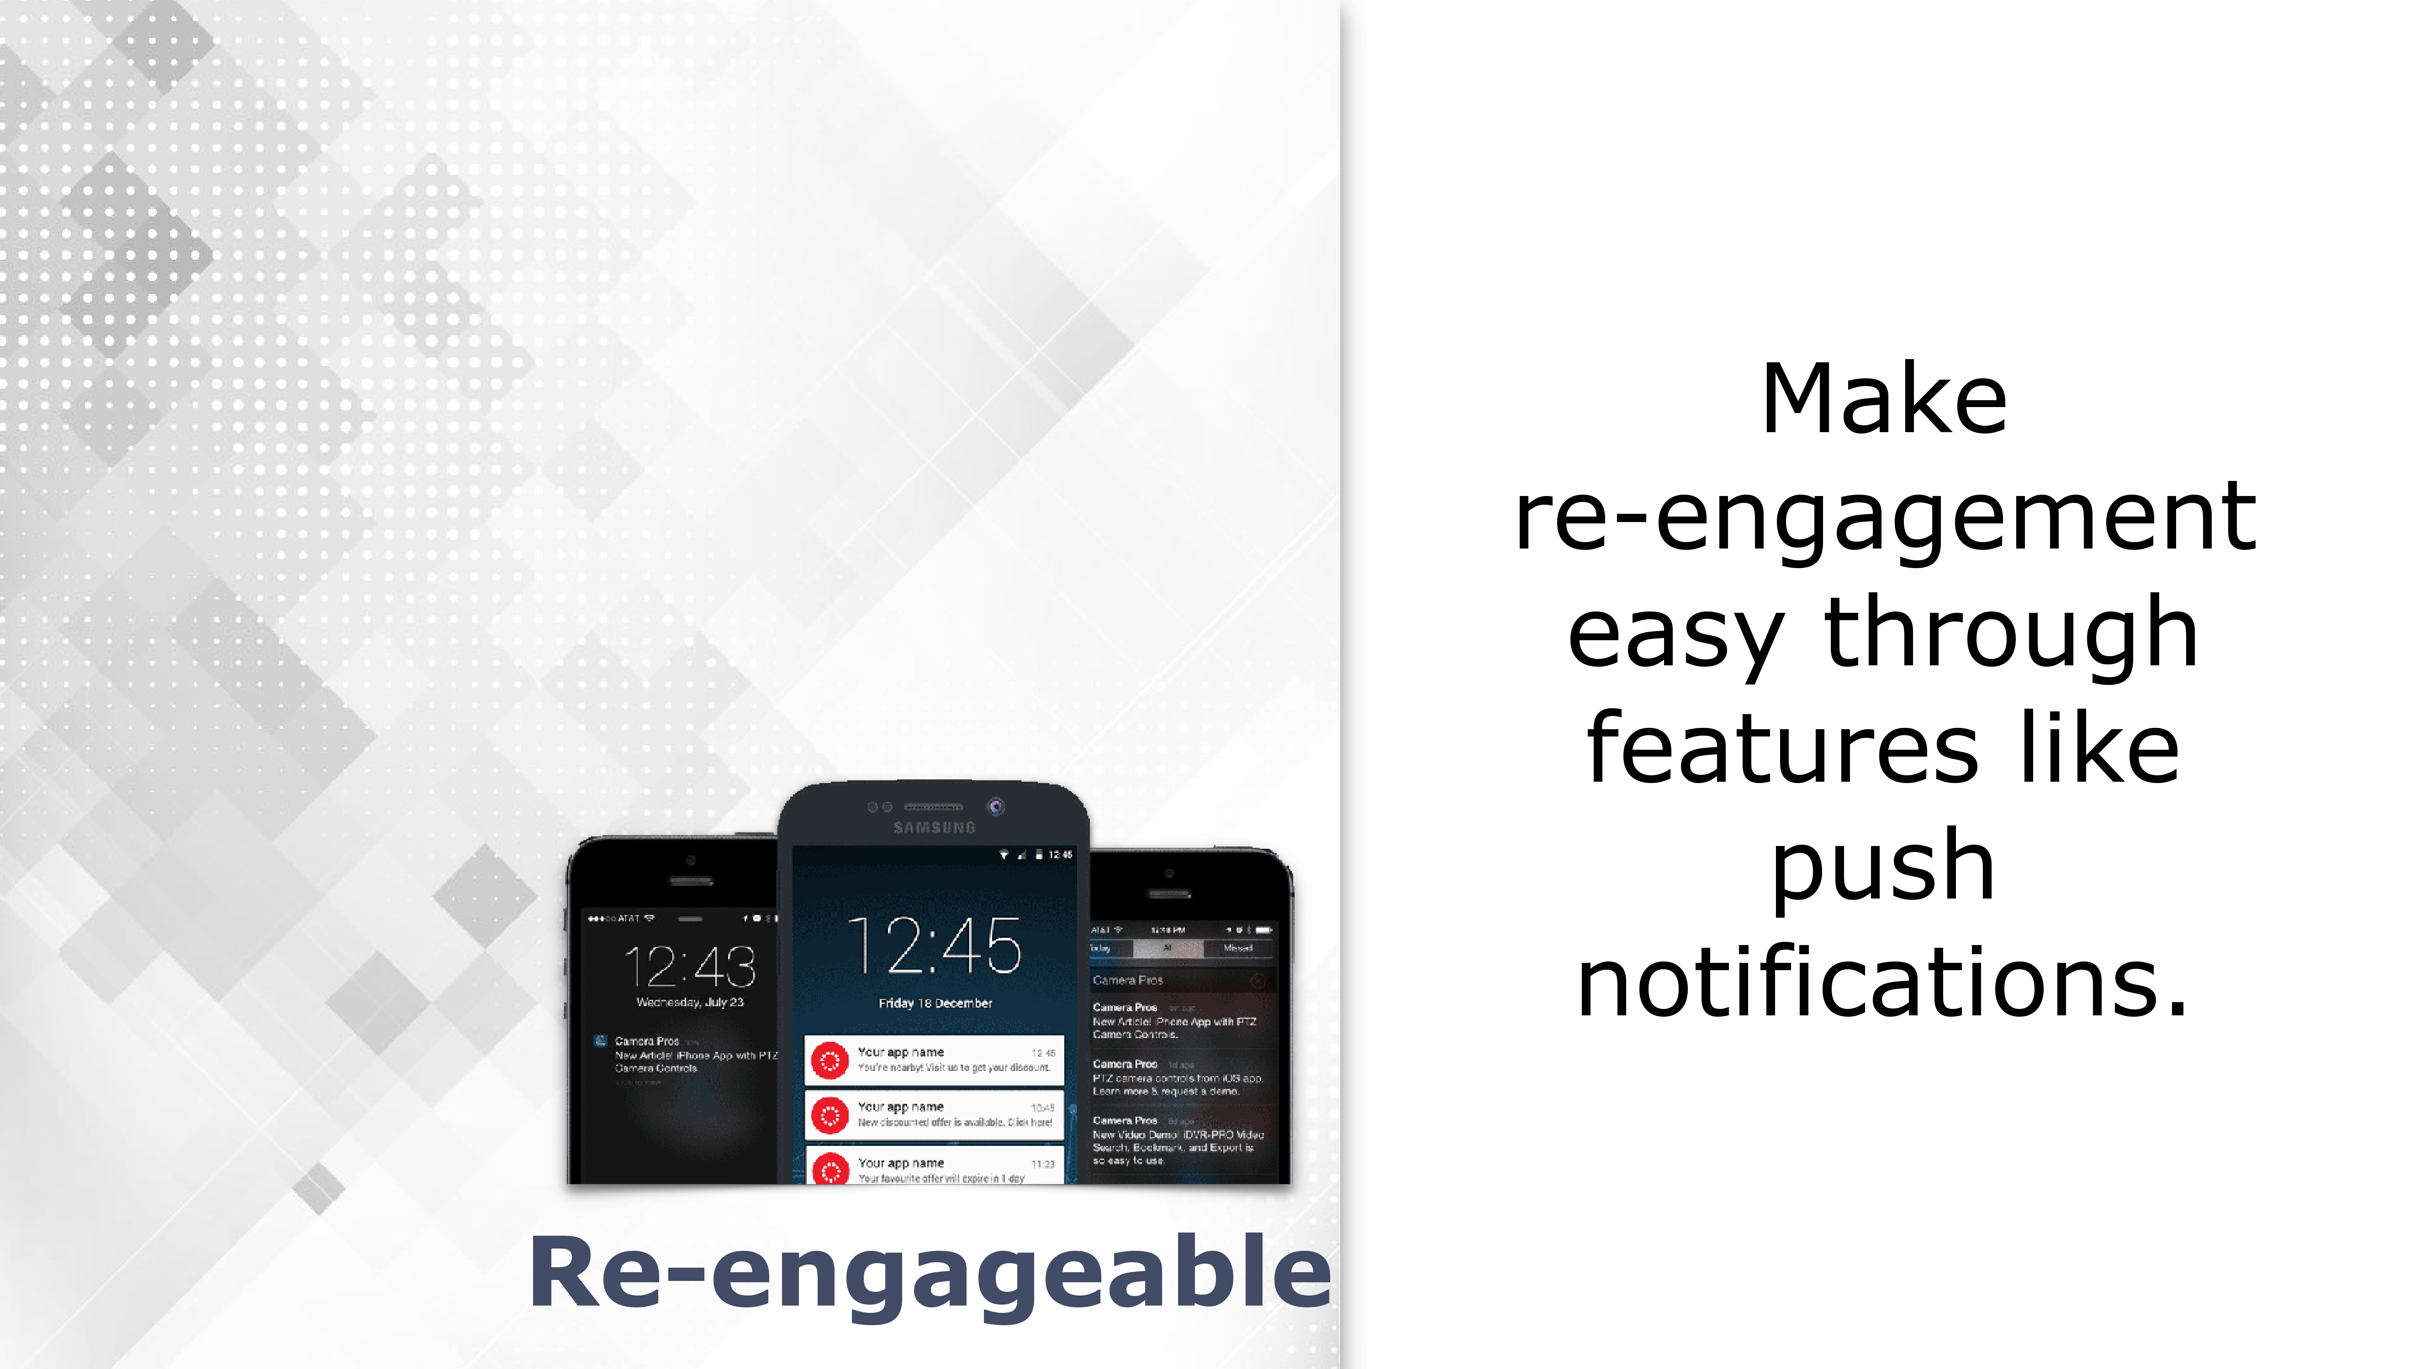

Slide 15

WHY
PWA?

Slide 16
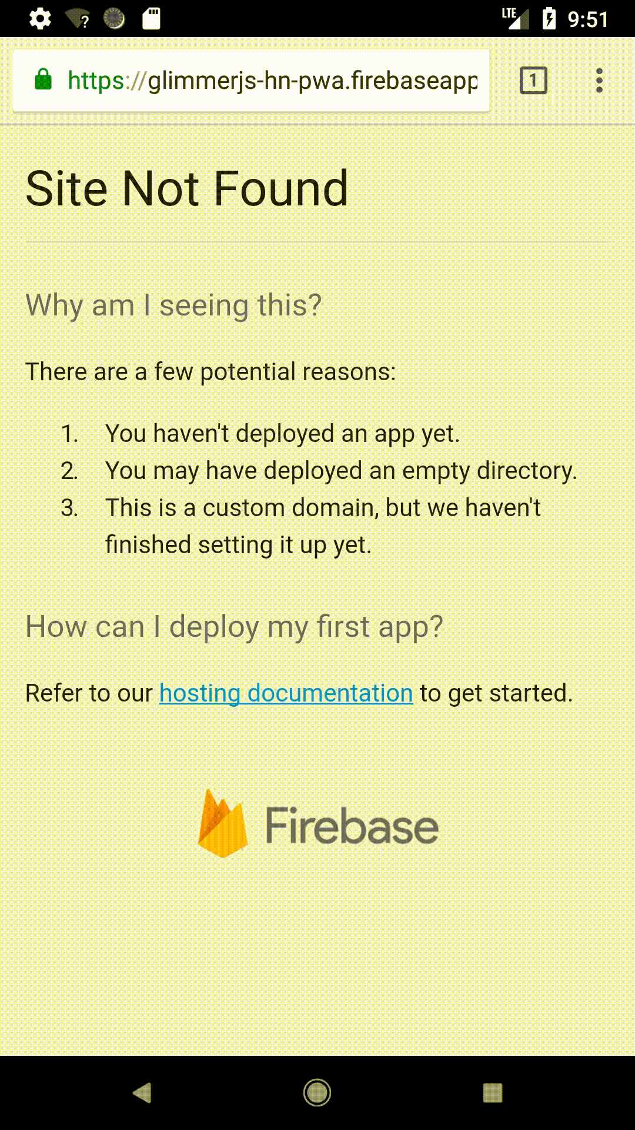

Slide 17


Slide 18

AWESOME
WORDPRESS

Slide 19
SSR
WP-REST-API SPA

Slide 20

ESSENTIAL
REQUIRMENTs

Slide 21
manifest.json
SW.js

Slide 22

MANIFEST
DOT JSON

Slide 23
<head>
<link rel="manifest" href="/manifest.json">
OR
<link rel="manifest" href="<?php echo get_manifest_path(); ?>">
</head>

Slide 24
{
"name": ”WP PWA",
"short_name": ”WPPWA",
"description": ”An Awesome Offline App with Wordpress",
"background_color": "#fff",
"theme_color": "#3f51b5",
"start_url": "/index.html?utm_source=homescreen",
"scope": ".",
"orientation": "portrait-primary",
"display": "standalone",
"dir": "ltr",
"lang": "en-US",
"icons": [{
"src": "/assets/images/icons/icon-512x512.png",
"type": "image/png",
"sizes": "512x512"
}]
}

Slide 25
{
"name": ”WP PWA",
"short_name": ”WPPWA",
"description": ”An Awesome Offline App with Wordpress",
"background_color": "#fff",
"theme_color": "#3f51b5",
"start_url": "/index.html?utm_source=homescreen",
"scope": ".",
"orientation": "portrait-primary",
"display": "standalone",
"dir": "ltr",
"lang": "en-US",
"icons": [{
"src": "/assets/images/icons/icon-512x512.png",
"type": "image/png",
"sizes": "512x512"
}]
}

Slide 26
{
"name": ”WP PWA",
"short_name": ”WPPWA",
"description": ”An Awesome Offline App with Wordpress",
"background_color": "#fff",
"theme_color": "#3f51b5",
"start_url": "/index.html?utm_source=homescreen",
"scope": ".",
"orientation": "portrait-primary",
"display": "standalone",
"dir": "ltr",
"lang": "en-US",
"icons": [{
"src": "/assets/images/icons/icon-512x512.png",
"type": "image/png",
"sizes": "512x512"
}]
}

Slide 27
DEMO TIME

Slide 28
SERVICE
WORKER

Slide 29



Single thread
Single thread
Service Worker
Notes:
Runs in additional thread
Runs in background even if we close pages
Doesn’t have access to DOM / HTML
Manages all pages (as long as they are under the scope)

Slide 30






Slide 31
REGISTER SERVICE WORKER

Slide 32
if ('serviceWorker' in navigator) {
navigator.serviceWorker.register('/sw.js')
.then( (reg) => console.log(reg))
.catch((error) => console.log('Registration failed with ' + error));
}

Slide 33
if ('serviceWorker' in navigator) {
navigator.serviceWorker.register('/sw.js')
.then( (reg) => console.log(reg))
.catch((error) => console.log('Registration failed with ' + error));
}

Slide 34
if ('serviceWorker' in navigator) {
navigator.serviceWorker.register('/sw.js', { scope: '/' })
.then( (reg) => console.log(reg))
.catch((error) => console.log('Registration failed with ' + error));
}

Slide 35
SCOPE

Slide 36
sw.php
<?
require('../../../../wp-load.php');
header('Service-Worker-Allowed: /');
header('Content-Type: application/javascript');
?>
__myconfig={themeUrl:`<?=get_bloginfo('template_url');?>`};
<?
readfile('sw.js');
?>

Slide 37
FOOTER.PHP
footer.php
if ('serviceWorker' in navigator) {
window.addEventListener('load', () => {
navigator
.serviceWorker
.register(`${__myconfig.themeUrl}/scripts/sw.php`);
});
}

Slide 38
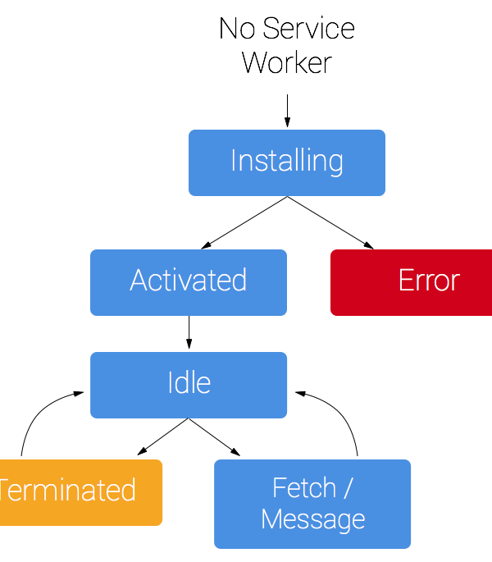
Service worker
Life Cycle

Slide 39
index.html
install
Install event
To cache asset for example
FETCH
app.js
active
error
Background sync
sw.js
idle
terminate
website
activate Event
SW can control all pages of the Scope
Notes:
Register as a background process /
Activate as soon as it should be activated not immiediately / for isntance new service worker / close tab open new tab
1byte or more sevice worker / might not install servicer worker if there is no updated version not on every page refresh
Actiavte -> idle -> terminated / sleep for insntace an event like fetch happen it comes back to idle and then again will go back to sleep.

Slide 40
DEMO TIME

Slide 41

CACH
STRATEGIES

Slide 42
FETCH EVENT
self.addEventListener('fetch',
(event) => {
console.log('[SW] Fetch ....');
const request = event.request;
event.respondWith()
}

Slide 43
FETCH EVENT
self.addEventListener('fetch',
(event) => {
console.log('[SW] Fetch ....');
const request = event.request;
event.respondWith()
}

Slide 44
Cache only
event.respondWith(
caches.match(request)
);

Slide 45
Network only
event.respondWith(
fetch(event.request)
);

Slide 46
Cache first, falling back to network
event.respondWith(
caches.match(request).then( (res) => {
return res || fetch(request).then( (newRes) => {
caches.open(DYNAMIC_CACHE_VERSION)
.then( cache => cache.put(request, newRes) );
return newRes.clone();
});
})
);

Slide 47
Cache first, falling back to network
event.respondWith(
caches.match(request).then( (res) => {
return res || fetch(request).then( (newRes) => {
caches.open(DYNAMIC_CACHE_VERSION)
.then( cache => cache.put(request, newRes) );
return newRes.clone();
});
})
);

Slide 48
Network first, falling back to cache
event.respondWith(
fetch(request)
.then((res) => {
caches.open(DYNAMIC_CACHE_VERSION)
.then(cache => cache.put(request, res));
return res.clone();
}) // Fallback to cache
.catch(err => caches.match(request))
);

Slide 49
Network first, falling back to cache
event.respondWith(
fetch(request)
.then((res) => {
caches.open(DYNAMIC_CACHE_VERSION)
.then(cache => cache.put(request, res));
return res.clone();
}) // Fallback to cache
.catch(err => caches.match(request))
);

Slide 50
Cache with Network Update
event.respondWith(
caches
.match(request).then((res) => {
const updatedResopnse = fetch(request).then((newRes) => {
cache.put(request, newRes.clone());
return newRes;
}); return res || updatedResopnse;
})
);

Slide 51
Cache with Network Update
event.respondWith(
caches
.match(request).then((res) => {
const updatedResopnse = fetch(request).then((newRes) => {
cache.put(request, newRes.clone());
return newRes;
}); return res || updatedResopnse;
})
);

Slide 52
WHAT
ELSE…

Slide 53
Payment Request API
allows Web applications to delegate the payment
checkout process to the operating system,
allowing it to use whatever methods and payment providers
are natively available for the platform and configured for the user.
Web Share API
the Navigator.share() method invokes the native sharing mechanism of the device as part of the Web Share API.
Battery Status
The Battery Status API allows Web applications
to get the information about the device's power source,
battery charge level, expected time of charging or discharging.
Vibration API
Give your user the best experience
with progressive enhancement
Push Notification
Push Messaging is the well-known re-engagement
mechanism from the mobile platforms
Credential Management
The Credential Management API allows authorized
Web applications to store and request user credentials
(like login and password or federated login data)
programmatically on behalf of the user.The API offers
a replacement for browser built-in or 3rd-party password stores
Background Sync
Reigster a task and sync back your data when
Connectivity restablished

Slide 54
AND EVEN MORE…

Slide 55
https://github.com/mhadaily/wordcamp2018Oslo

Slide 56
THANK YOU
See You Next Time
MAJID HAJIAN
@mhadaily

